Slide 1

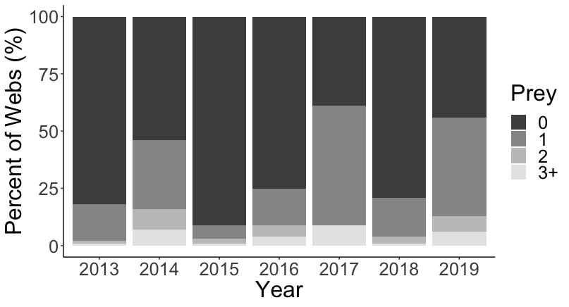
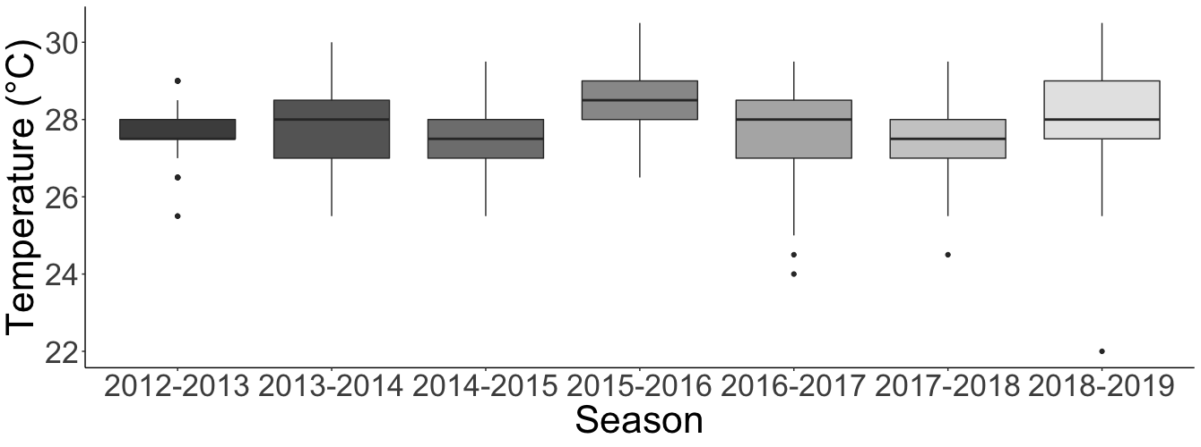
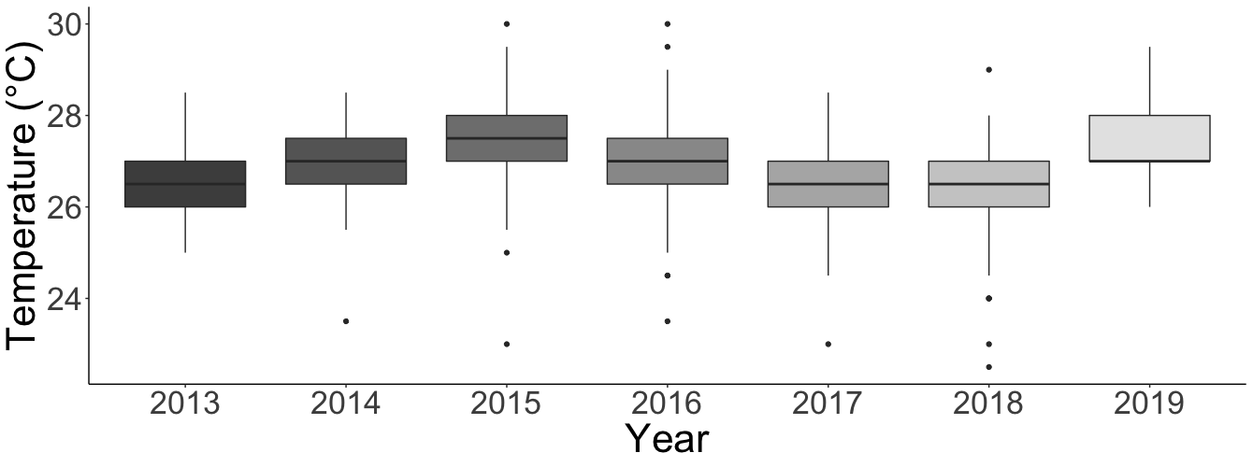
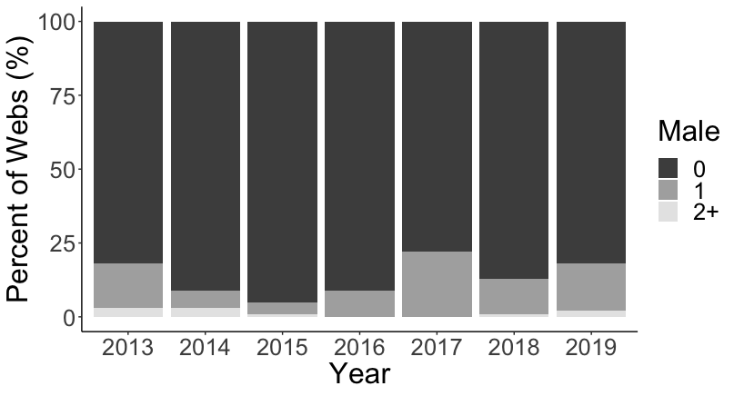
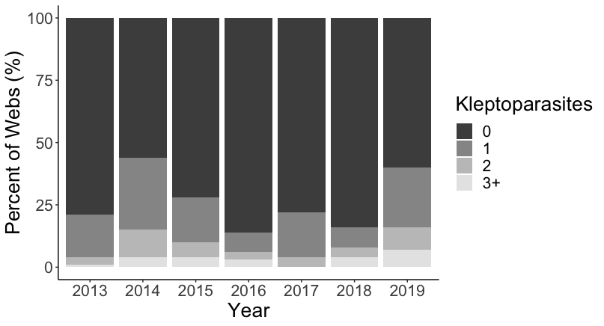
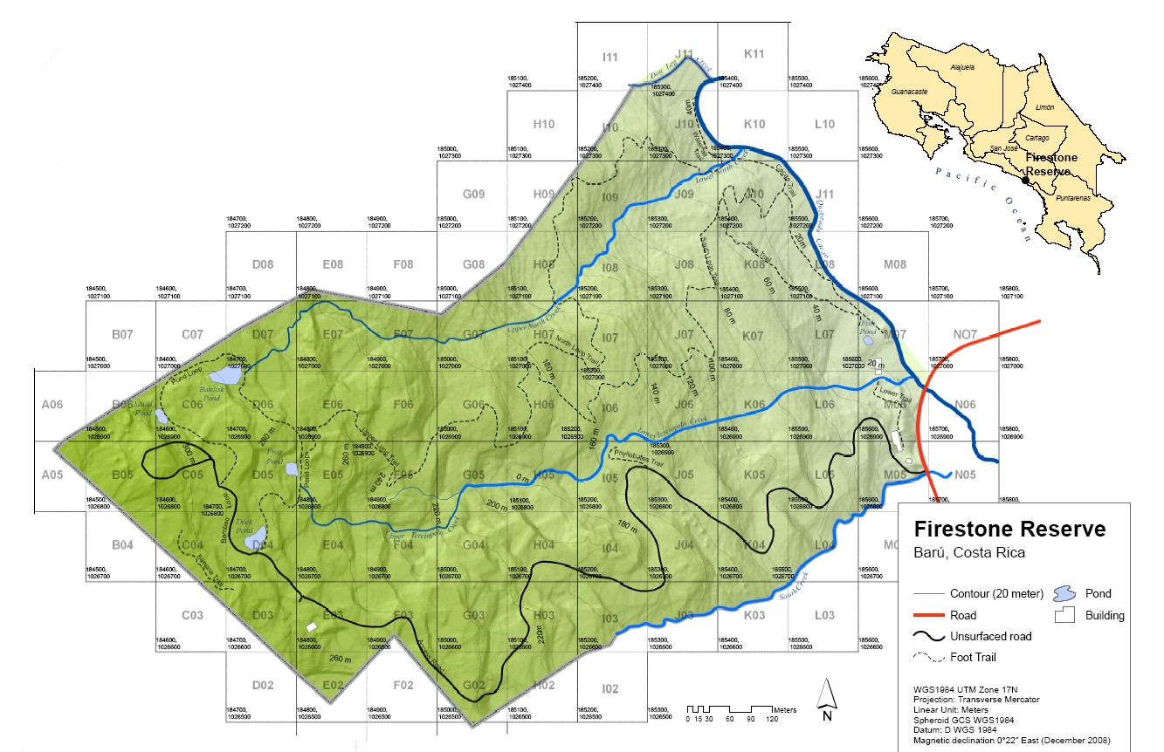
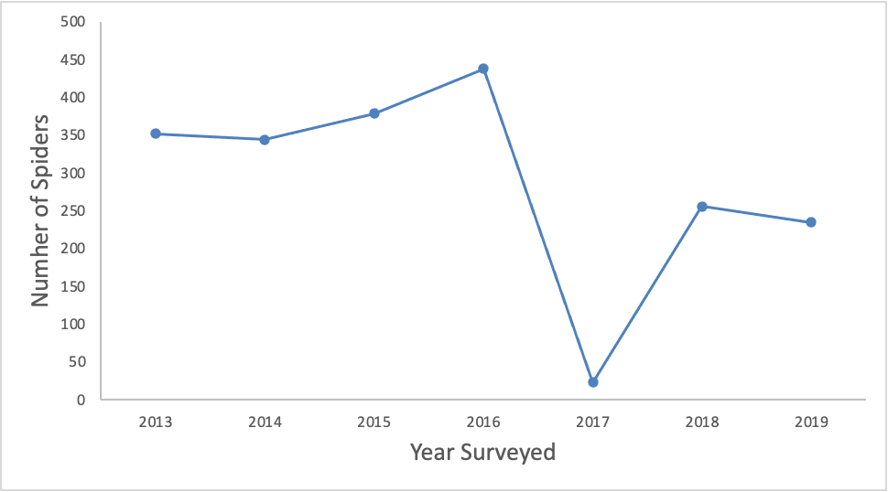
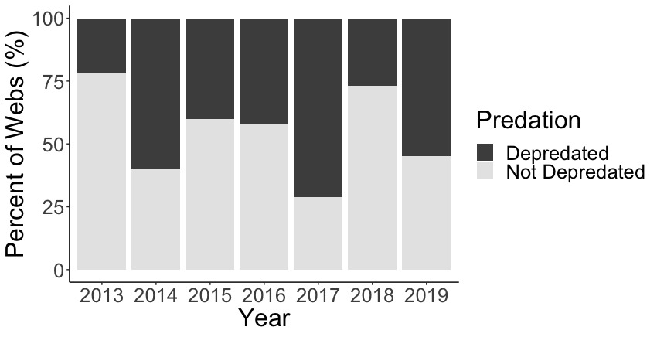
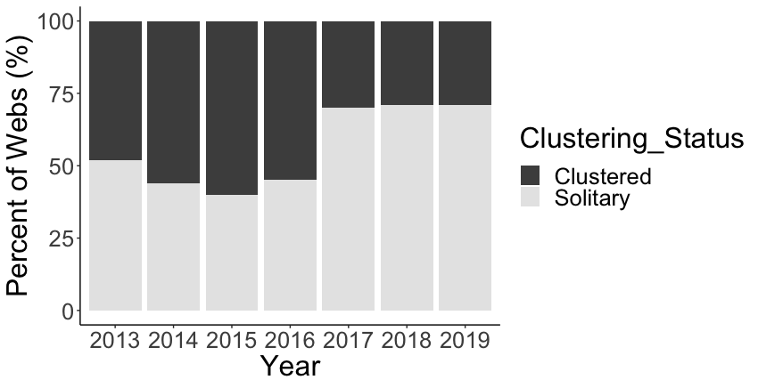
Environmental and Biological Factors of Population Fluctuations in Golden Orb-Weaver Spiders
Emma Reder, Environmental Science, Scripps College
W. M. Keck Science Department
Claremont McKenna • Scripps • Pitzer
Introduction
Results
  Insects have a major role in processes including nutrient cycling¹, pollination^{2,3}, herbivory and detrivory^{4,1} as well as serving as a food source for higher trophic levels including amphibians, birds, and mammals.
  A growing number of studies are finding significant declines in arthropods, including spiders⁵.
  Using daily monitoring data and environmental data collected over several years, we investigated potential drivers of the fluctuations we have observed in a population of golden orb-weaver spiders, Nephila clavipes, in a relatively undisturbed tropical rainforest in Costa Rica.
  Because this study is over a relatively short time span (7 years), we cannot determine whether our N. clavipes study population is declining or cycling.
  Cycles in arthropod populations can be attributed to density-dependent interactions between arthropods and their food, competitors, or enemies⁶. Fluctuations in abiotic factors ( such as temperature) also drive cyclic changes over time⁶.
a)
a)
a) Average temperature in dry season
Prediction: Extreme high/low temperatures in 2016
Result: Average temperature greater in 2015-16 than all other years
b) Average temperature in wet season
Prediction: Extreme high/low temperatures in 2016
Result: Average temperature fluctuates
a) Percentage of webs with prey
Prediction: Least prey in 2016 and 2017
Result: More prey in 2017 vs. all years
b) Percentage of webs with males
Prediction: Least males in 2016 and 2017
Result: Not significant
c) Percentage of webs with kleptoparasites
Prediction: Kleptoparasites reflect food availability
Result: Not significant
b)
b)
Discussion
Methods
c)
  Based on a preliminary analysis, none of the factors are related to the 2017 population decline of the N. clavipes population.
  In the weather data, there are fluctuations in temperature without clear patterns.
  Parasites were first observed in 2014 and dark color morphs of N. clavipes were first observed in 2016. Future studies could explore the effects of color morphing and parasites.
  Future studies could assess the N. clavipes population over a longer time frame to determine whether the population is experiencing normal cycling or a decline.
  Study conducted from 2013-2019 in Barú, Costa Rica (Figure 1).
  We studied spiders along a 2km trail and found a large reduction in the population in 2017 (Figure 2).
  Daily population monitoring for three weeks per web: spider abundance (males and females), insect prey abundance, kleptoparasite abundance, predation rates, clustering status.
  Daily minimum/maximum temperature was obtained from weather stations at Hacienda Barú.
Literature Cited
Depredation
Prediction: Increased predation before the decline
Result: Not significant
Yang, L. H., & Gratton, C. (2014). Current Opinion in Insect Science, 2, 26–32.
Öckinger, E., & Smith, H. G. (2007). Journal of Applied Ecology, 44(1), 50–59.
Ollerton, J., Winfree, R., & Tarrant, S. (2011). Oikos, 120(3), 321–326.
Mattson, W. J., & Addy, N. D. (1975). Science, 190(4214), 515–522.
Seibold, S., Gossner, M. M., Simons, N. K., Blüthgen, N., Müller, J., Ambarlı, D., Ammer, C., Bauhus, J., Fischer, M., Habel, J. C., Linsenmair, K. E., Nauss, T., Penone, C., Prati, D., Schall, P., Schulze, E.-D., Vogt, J., Wöllauer, S., & Weisser, W. W. (2019). . Nature, 574(7780), 671–674.
Hunter, M. D., & Price, P. W. (1998). Ecological Entomology, 23(2), 216–222.
Ferree, E., Johnson, S., Barraza, D., Crabo, E., Florio, J., Godtfredsen, H., Holland, K., Jitmana, K., & Mark, K. (2018). Behavioral Ecology and Sociobiology, 72(10), 157.
Clustering
Prediction: Low clustering rates in 2016 would lead to high predation⁷
Result: Not significant
Acknowledgements
Figure 1. Field site in Costa Rica.
Figure 2. Line chart showing variation in the number of spider webs per year.
I would like to thank Professor Ferree for her guidance and support throughout this project. I would also like to thank Professor Faldyn for his support with the statistical analyses. I would like to recognize the student contributors to this project including Stephen Johnson, Daniella Barraza, Emma Crabo, Jenna Florio, Haley Godtfredsen, Kennedy Holland, Kanyarat Jitmana, Kaya Mark, Gabriela Ochoa, Sabrina Wu, Sophie Boerboom, Jiravit Moontep, Chloe Lesh and River Joo. Finally, I thank fellow thesis students, Lauryn Jeans and Sydney Ross, for their feedback throughout the semester.

